Slide 1
SOFTWARE REQUIREMENT SPECIFICATION

Slide 2
Software Requirement Specification
A software requirements specification (SRS) is a comprehensive description of the intended(planned) purpose and environment for software under development.
The SRS fully describes what the software will do and how it will be expected to perform.

Slide 3
Software Requirement Specification
An SRS minimizes the time and effort required by developers to achieve desired goals and also minimizes the development cost.
A good SRS defines how an application will interact with system hardware, other programs and human users in a wide variety of real-world situations. (Functional Requirements)

Slide 4
Functional requirements
Describe functionality or system services.
Depend on the type of software, expected users and the type of system where the software is used.
Functional user requirements may be high-level statements of what the system should do but functional system requirements should describe the system services in detail.

Slide 5
The LIBSYS system
A library system that provides a single interface to a number of databases of articles in different libraries.
Users can search for, download and print these articles for personal study.

Slide 6
Examples of functional requirements
The user shall be able to search either all of the initial set of databases or select a subset from it.
The system shall provide appropriate viewers for the user to read documents in the document store.
Every order shall be allocated a unique identifier (ORDER_ID) which the user shall be able to copy to the account’s permanent storage area.

Slide 7
Requirements Imprecision
Problems arise when requirements are not precisely stated.
Ambiguous requirements may be interpreted in different ways by developers and users.
Consider the term ‘appropriate viewers’
  User intention - special purpose viewer for each different document type;
  Developer interpretation - Provide a text viewer that shows the contents of the document.

Slide 8
Software Requirement Specification
An SRS minimizes the time and effort required by developers to achieve desired goals and also minimizes the development cost.
A good SRS defines how an application will interact with system hardware, other programs and human users in a wide variety of real-world situations. (Functional Requirements)

Slide 9
Parameters such as
  operating speed,
  response time,
  availability,
  portability,
  maintainability,
  security and
  speed of recovery from adverse events are evaluated. (Non Functional Requirements)

Slide 10
Non-functional requirements
These define system properties and constraints e.g. reliability, response time and storage requirements. Constraints are I/O device capability, system representations, etc.
Process requirements may also be specified mandating a particular CASE system, programming language or development method.
Non-functional requirements may be more critical than functional requirements. If these are not met, the system is useless.

Slide 11
Non-functional classifications
Product requirements
  Requirements which specify that the delivered product must behave in a particular way e.g. execution speed, reliability, etc.
Organisational requirements
  Requirements which are a consequence of organisational policies and procedures e.g. process standards used, implementation requirements, etc.
External requirements
  Requirements which arise from factors which are external to the system and its development process e.g. interoperability requirements, legislative requirements, etc.

Slide 12
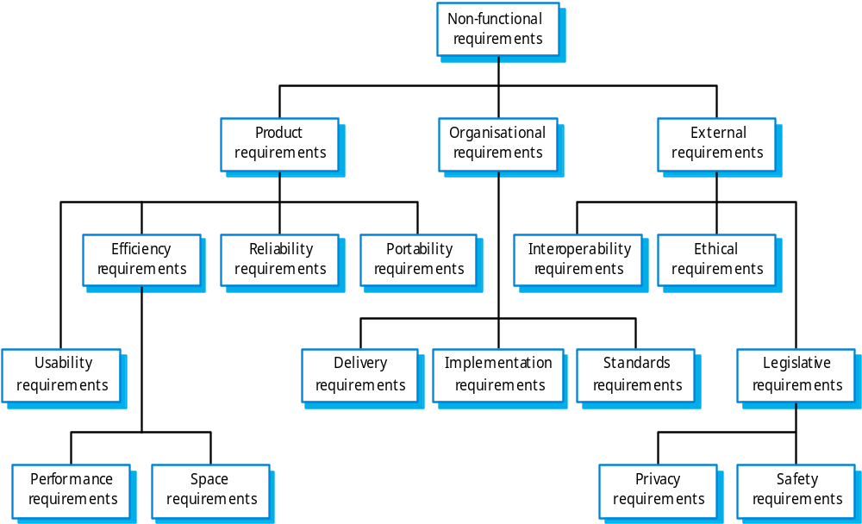
Non-functional requirement types

Slide 13
Non-functional requirements examples
Product requirement
  8.1 The user interface for LIBSYS shall be implemented as simple HTML without frames or Java applets.
Organisational requirement
  9.3.2 The system development process and deliverable documents shall conform to the process and deliverables defined in XYZCo-SP-STAN-95.
External requirement
  7.6.5 The system shall not disclose any personal information about customers apart from their name and reference number to the operators of the system.

Slide 14
What are the benefits of a Great SRS?
The IEEE 830 standard defines the benefits of a good SRS:
Establish the basis for agreement between the customers and the suppliers on what the software product is to do.
  The complete description of the functions to be performed by the software specified in the SRS will assist the potential users to determine if the software specified meets their needs or how the software must be modified to meet their needs. [NOTE: We use it as the basis of our contract with our clients all the time].

Slide 15
Benefits of a Great SRS
Reduce the development effort.
  The preparation of the SRS forces the various concerned groups in the customer’s organization to consider rigorously all of the requirements before design begins and reduces later redesign, recoding, and retesting.
  Careful review of the requirements in the SRS can reveal omissions, misunderstandings, and inconsistencies early in the development cycle when these problems are easier to correct.

Slide 16
Benefits of a Great SRS
Provide a basis for estimating costs and schedules.
  The description of the product to be developed as given in the SRS is a realistic basis for estimating project costs and can be used to obtain approval for bids or price estimates. [NOTE: Again, we use the SRS as the basis for our fixed price estimates]

Slide 17
Benefits of a Great SRS
Provide a baseline for validation and verification.
  Organizations can develop their validation and Verification plans much more productively from a good SRS. As a part of the development contract, the SRS provides a baseline against which compliance can be measured. [NOTE: We use the SRS to create the Test Plan].

Slide 18
Benefits of a Great SRS
Facilitate transfer.
  The SRS makes it easier to transfer the software product to new users or new machines.
  Customers thus find it easier to transfer the software to other parts of their organization, and suppliers find it easier to transfer it to new customers.

Slide 19
Benefits of a Great SRS
Serve as a basis for enhancement.
  Because the SRS discusses the product but not the project that developed it, the SRS serves as a basis for later enhancement of the finished product.
  The SRS may need to be altered, but it does provide a foundation for continued production evaluation. [NOTE: This is often a major pitfall – when the SRS is not continually updated with changes]

Slide 20
What should the SRS address?
Again from the IEEE standard the basic issues that the SRS writer(s) shall address are the following:
Functionality.
  What is the software supposed to do?
External interfaces.
  How does the software interact with people, the system’s hardware, other hardware, and other software?
Performance.
  What is the speed, availability, response time, recovery time of various software functions, etc.?

Slide 21
Attributes.
  What are the portability, correctness, maintainability, security, etc. considerations?
Design constraints imposed on an implementation.
  Are there any required standards in effect, implementation language, policies for database integrity, resource limits, operating environment(s) etc.?

Slide 22
What are the characteristics of a great SRS?
Again from the IEEE standard an SRS should be
  Correct
  Unambiguous
  Complete
  Consistent
  Ranked for importance and/or stability
  Verifiable
  Modifiable
  Traceable

Slide 23
Correct –
  The specification has to be correct. No one writes a specification that they know is incorrect.
  The discipline is keeping the specification up to date when you find things that are not correct.
Unambiguous –
  An SRS is unambiguous if, and only if, every requirement stated therein has only one interpretation.

Slide 24
Complete –
  A simple judge of this is that is should be all that is needed by the software designers to create the software.
Consistent –
  The SRS should be consistent within itself and consistent to its reference documents.
    If you call an input "Start and Stop" in one place, don't call it "Start/Stop" in another.

Slide 25
Ranked for Importance –
  Very often a new system has requirements that are really marketing wish lists. Some may not be achievable. It is useful provide this information in the SRS.
Verifiable –
  Don't put in requirements like –
    "It should provide the user a fast response.“
    "The system should never crash."
  Instead, provide a quantitative requirement like: "Every key stroke should provide a user response within 100 milliseconds."

Slide 26
Modifiable –
  Having the same requirement in more than one place may not be wrong - but tends to make the document not maintainable.
Traceable –
  Often, this is not important in a non-politicized environment. However, in most organizations, it is sometimes useful to connect the requirements in the SRS to a higher level document.

